Slide 1
Artila PE team Current Issues

Slide 2
RMA No. Release procedures
Suggest : RMA Form released by PE team
RMA data statitics
RMA form items identification
RMA Form Item name : Chinese and English
Modification: RMA Request Synopsises and Repair Treatments
MD file transfer to PDF format
RMA form put photos or not
RMA form show on Website of Artila
Suggest one form can be organized in one form

Slide 3

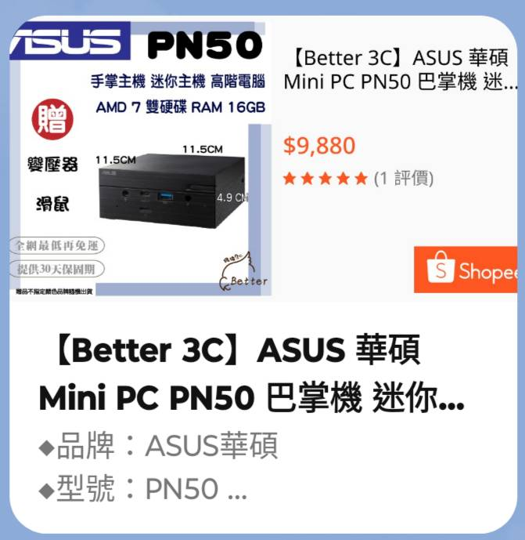
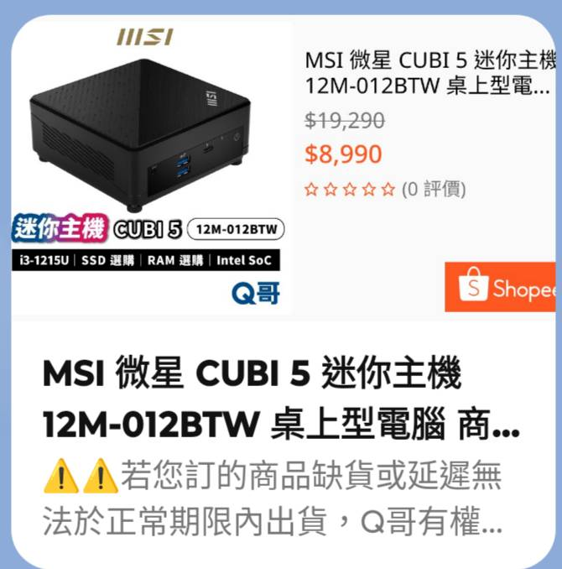
PE team tools and database
Working Tools: There are three model of mini PCs shown on below
Win XP testing file transfer to Win 10 /11.

Slide 4



PE mission assignment
Initial Stage: Daily review and arrange job assignments
GitHub database : Learning & Maintain
Options: ChatGPT or Gemini learning
Working environment tide up and organized

